Slide 2
LABRADOR MAX
LANA PEIĆ

Slide 3
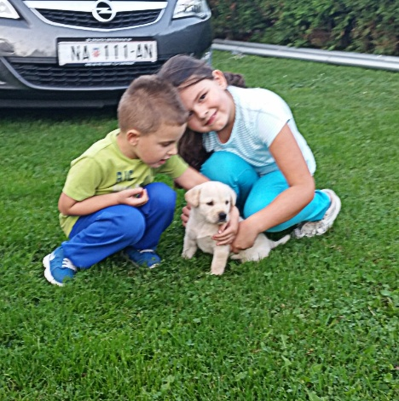
NAME | MAX
LOOKS | White golden hair sometimes fluffy, kinda tall(for a dog), he has a little nose, big ears that fly when he runs
PERSONALATY | Playfull, faithfull, calm, he loves going for a long walks an he often plays with his squeezy toys
AGE | 6 years old
FOOD HE EATS | He eats his dog food, brand: chappi
HOME | A house in our garden but he is the most of the time in the house
VACCINE | Against rabies
CURIOSITIES | He loves to dig hooles in our garden, he is healty and swims very fast, he goes to sea side with us

Slide 7
BONI ANTEA ŽANKO 6.C

Slide 8
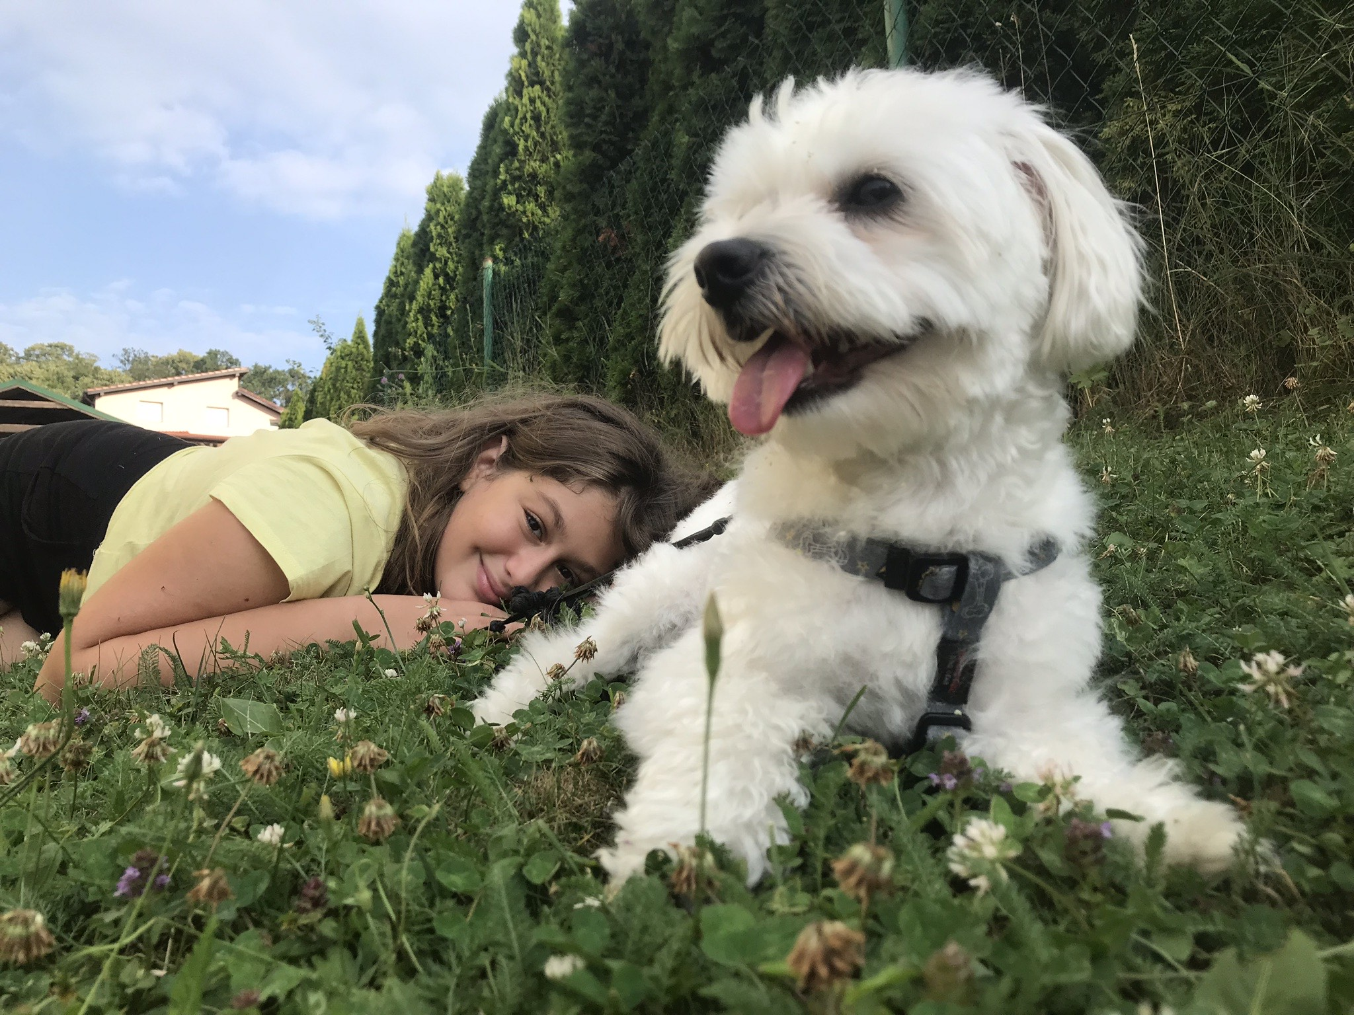
Name:Boni Breed:Maltese Age:3 years Hair:White Eyes:Black Food:His coockies Home:he sleeps under my bed or on his pillow Vaccination:against rabies Weight:4kg Origin:Malta

Slide 9
ŠAPICA
ANA STEFANI KUMRIĆ

Slide 10
NAME: | Šapica
LOOKS: | He has brown furr, tiny legs and small ears. His paws are a bit darker color then his body so that’s why we called him "Paws".
PERSONALATY: | He is very playfull and sometimes childish. He always gets happy when I come.I have a lot of trust in him, he's a good protector even tho he easily gets scared. He is allways running around and catching balls.
AGE: | He is one, almost two years old.
FOOD HE LIKES: | He isn't very picky,he can eat basiclly everything, but his favourite is cooked eggs and bacon.
HIS "HOME": | When we adopted him we builted him his little house from leftovr bricks. Inside he has a bed,lots of toys and bowls filled with food and water.
FUN FACTS: | He likes to play with cats but he's extreamly scared of balloons, he also never gets tired of runing.

Slide 11
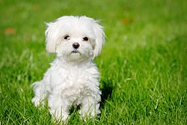
MALTEZER RIKI
Anita Kostreš
Valentina Šprem
6.c
This Photo by Unknown author is licensed under CC BY-SA.

Slide 12
LOOKS | Fluffy white hair,very small,skinny(3 pounds),small ears,black eyes,little tail
PERSONALATY | Playfull,aggressive,loves to eat dog bones and going for long walks
AGE | 20/6/17 2 years and 8 months
FOOD | Dog biscotti,BREND:Scotty junior Dog food,BREND:purina junior
HOME | He lives in my grendmothers hause
VACCINE | Against rabies Last time:18/9/19
CURIOSITIES | He loves jumping in the snow

Slide 13
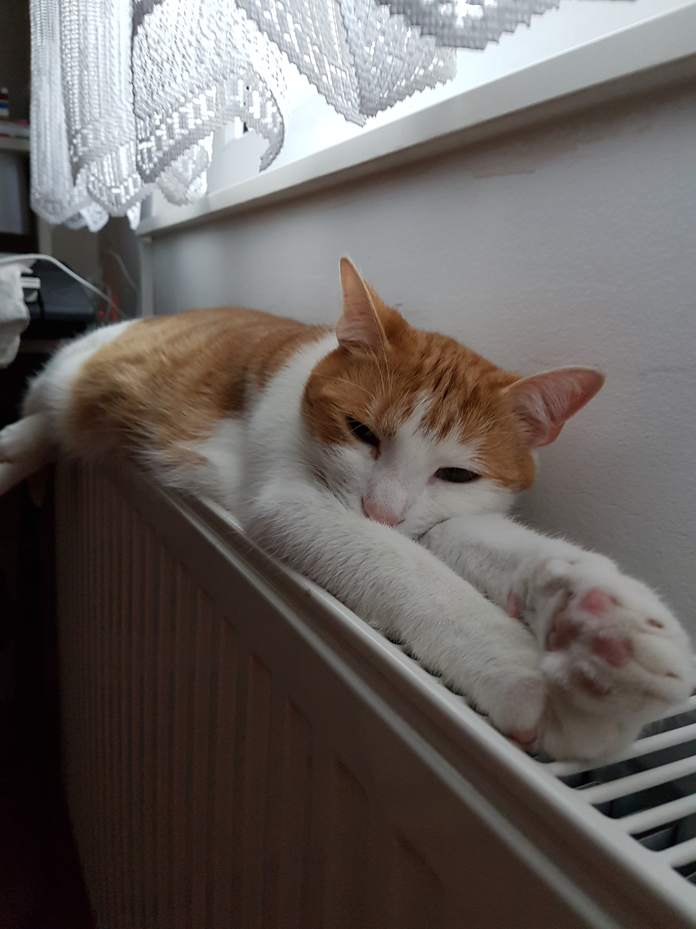
Moj kućni ljubimac
Eleonora Begić 6.c

Slide 14
Điđi
Name: Điđi(Gigi)
Looks: he has very thick but also soft fur, he has a mix of some yellow, orange
and white fur
Characteristics: he is loyal just for his owners(me) that take care of him, he is really stubborn and spoiled but we love him the way he is
Age: he is born somwhere around 24th of February 2014(around 6 years old)
Diet: he eats cats biscuits, something like sauce for cats and he also loves cream and cheese
Habitat: he never goes out but he has his own balconies, he can sleep where he wants but his favourite place is in my bed

Slide 15
Vaccinations: he is vaccinated for all diseases
Fun facts: he loves to play and bite our bare foots
he hates water
He hates travelling with us
He loves to talk(meow) with us
He loves morning, afternoon and night cuddles

Slide 16
Moj kućni ljubimac
Eleonora Begić 6.c

Slide 17
Điđi
Name: Điđi(Gigi)
Looks: he has very thick but also soft fur, he has a mix of some yellow, orange
and white fur
Characteristics: he is loyal just for his owners(me) that take care of him, he is really stubborn and spoiled but we love him the way he is
Age: he is born somwhere around 24th of February 2014(around 6 years old)
Diet: he eats cats biscuits, something like sauce for cats and he also loves cream and cheese
Habitat: he never goes out but he has his own balconies, he can sleep where he wants but his favourite place is in my bed

Slide 18
Vaccinations: he is vaccinated for all diseases
Fun facts: he loves to play and bite our bare foots
he hates water
He hates travelling with us
He loves to talk(meow) with us
He loves morning, afternoon and night cuddles

Slide 19
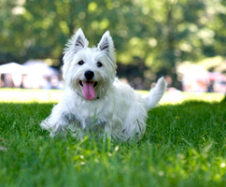
Luka Koljenik
My pet

Slide 20
I have a dog. My dog's name is Grom. He is currently 5 years old and he is very happy dog. He likes to go to long walks, and sometimes he likes to play with the ball. His favorite meal is sausage. I like to spend my time with my dog in my backyard. Depends on what season it is, my dog sometimes used to have alergic reactions, so he have to take medicine. My dog usually loves children and happy and positive people. Every few months he is going to the pet barber. They are giving him fresh haircut.

Slide 21
PETS
Made by Paula Kašuba 6.c
Professor leopoldina vitković

Slide 22
SOMETIHING ABOUT HIM
NAME Rex
EXTERIOR shades of browns
TRAIT DESCRIPTION rex is fun, always ready to play, adores going to the lake with Tia but his favorite thing is food and treats.
AGE 6 years old
DIET loves to eat a variety of treats
DWELLINGS rex lives in backyard where dad built a big red house that he shares with Tia
VACCINATION against rabies and sterilized
CURIOSSITIES Rex is a very playful dog, loves to play with his ball and run.

Slide 23
REX

